Slide 1


Slide 2

Online Portal for Elementary Education Management Information System (EEMIS)

Slide 3
Group Members Introduction
F22023937D
Bushra Yousaf BC190404019

Slide 4
INTRODUCTION OF PROJECT
Management Information System (MIS) is a computer-based system consisting of hardware, software, networked devices, and information that serves as the backbone of any organization. An MIS gathers data from multiple online systems or resources, analyzes the information, and reports data to aid in decision-making.
Online portal for Elementary Education Management Information System (EEMIS) is a web portal that is used to convert the manual information system of elementary education department into online web system. This system is capable to collect online data from various schools located in various districts of the province. The schools or educational institutions will connect to the portal through VPN or App, using authentication mechanism of username and password. The collected information includes the teachers and student’s data that will be provided by the school administrations located at far flung area of the province. This system will facilitate each level of management in Elementary Education Department. Using this portal, the top, middle and low level management of Education Department gains the information about teachers, staff and students to improve their performance and carry out optimal decision making.

Slide 5
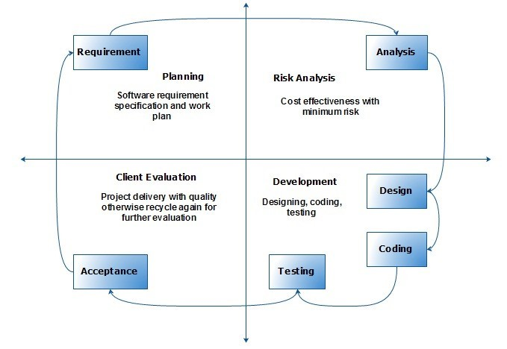
VU Process Model Diagram

Slide 6
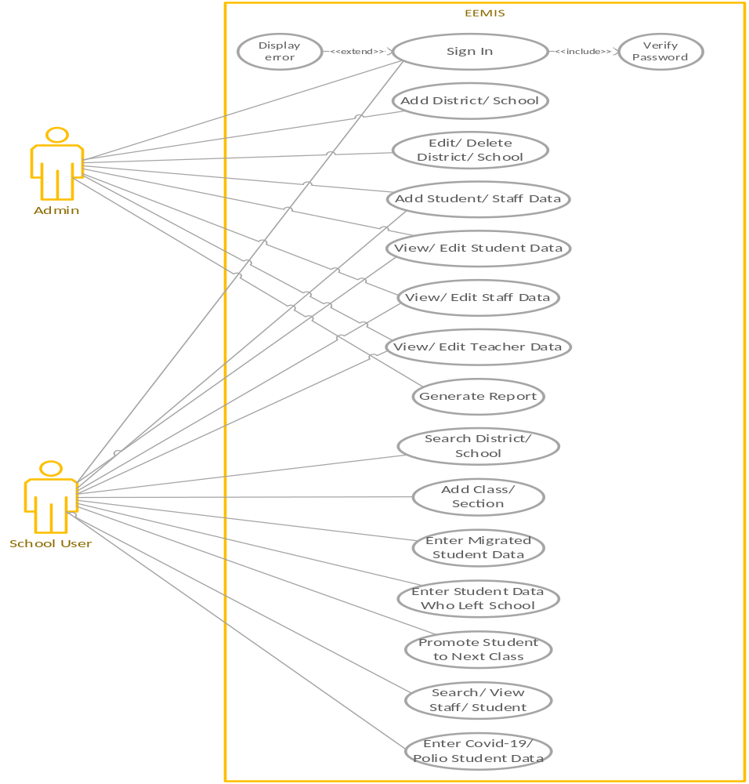
Use Case Diagram

Slide 7
Business Rules Catalog
User (School Administration)
  Login into the system
  Search the district and concerned school
  Add the serving teachers and staff data
  Create classes and sections after searching the school
  Enter the data of enrolled students in each section of class for each shift
  Enter the migrated student’s data
  Enter the data of students left the school
  Promote the students to next class
  Search and view the school-wise staff and student’s data
  Search and view the shift-wise staff and student’s data
  Search and view the class-wise and section-wise student’s data
  Search and view the individual staff and student’s data
  Search and view the covid-19 and polio vaccinated staff/students’ data
  Search and view the migrated student’s data
  Search and view the student’s data who left the school
  Edit/delete the teachers and staff data
  Edit/delete the class, section and student’s data
  Logout from the system

Slide 8
Business Rules Catalog
Admin
  Login into the system
  Add the name of Districts and schools
  Edit/delete the name of District and schools
  Assign/update username and password to end-users (school’s administration)
  View/edit the District-wise students, teachers and staff data
  View/edit the school-wise students, teachers, and staff data
  Generate various reports on teachers and staff data
  Produce various reports on student’s data

Slide 9
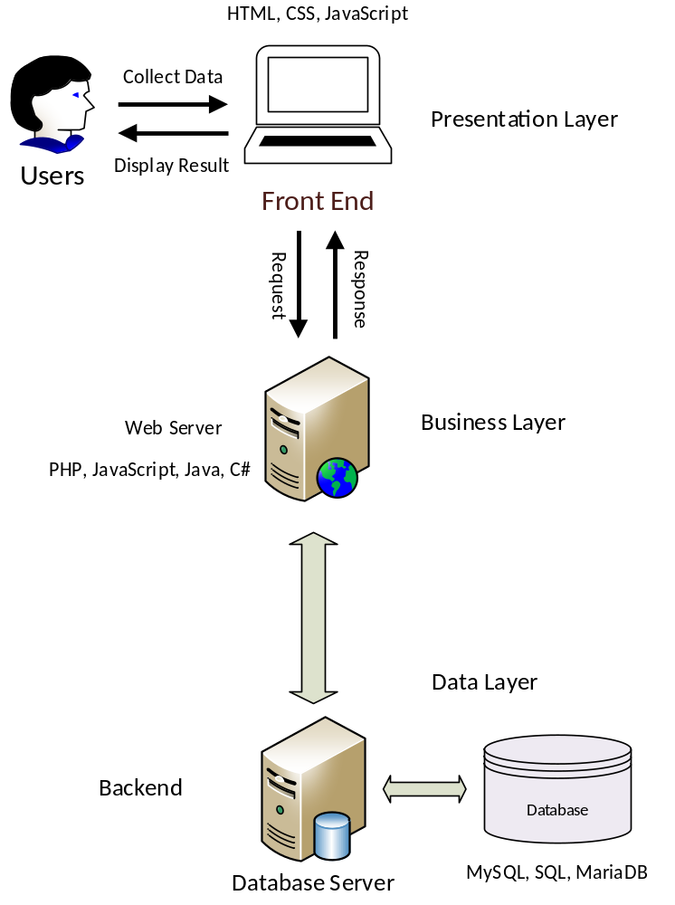
Architecture Diagram

Slide 10
Team Structure
Instructor
(Mir Salam Khan)
Student
(BC190404019)
Designer
Developer
Tester

Slide 11
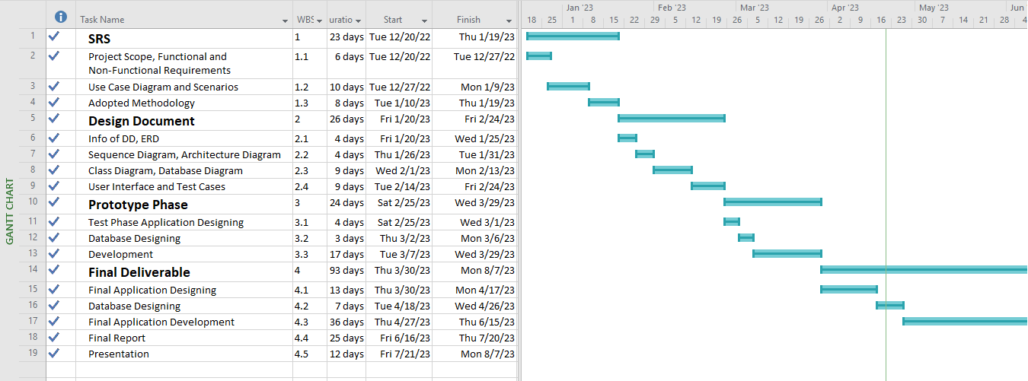
Project Schedule

Slide 12
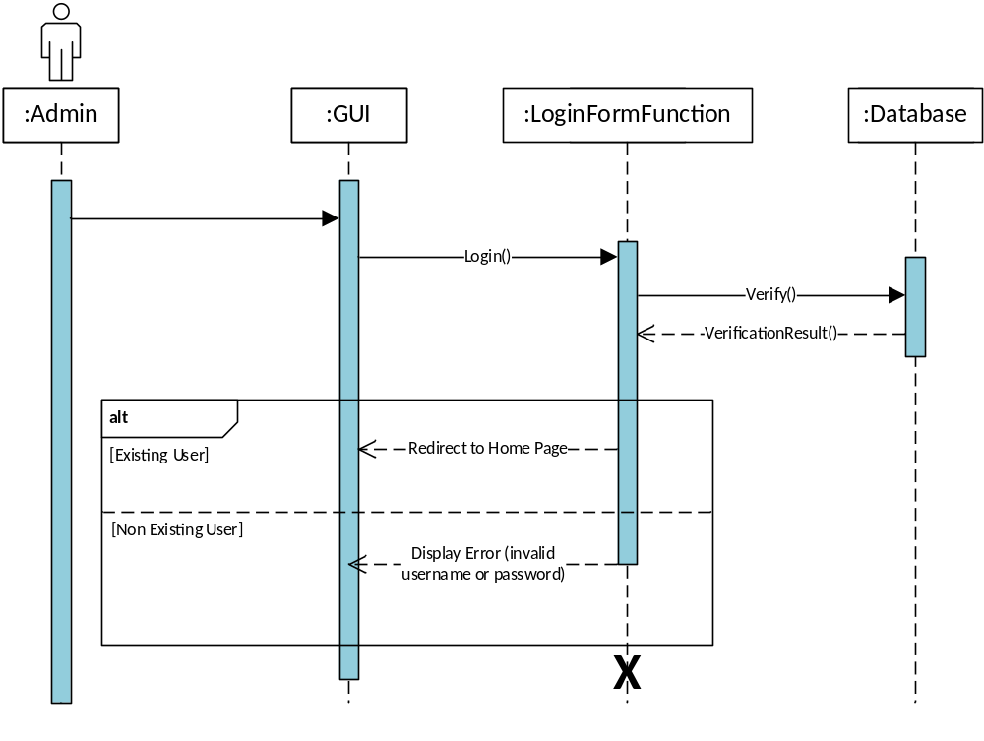
Sequence Diagrams
Login Sequence

Slide 13
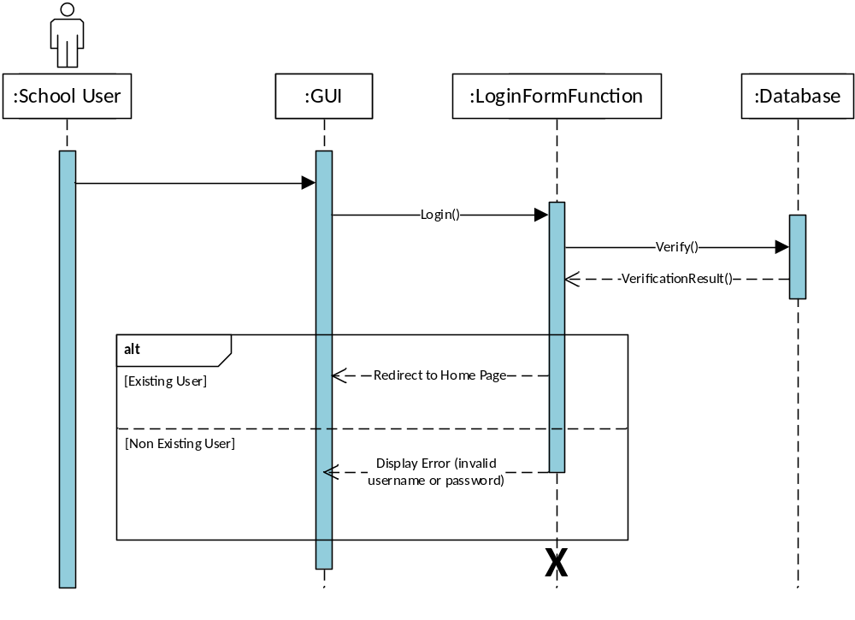
Sequence Diagrams
User Login Sequence

Slide 14
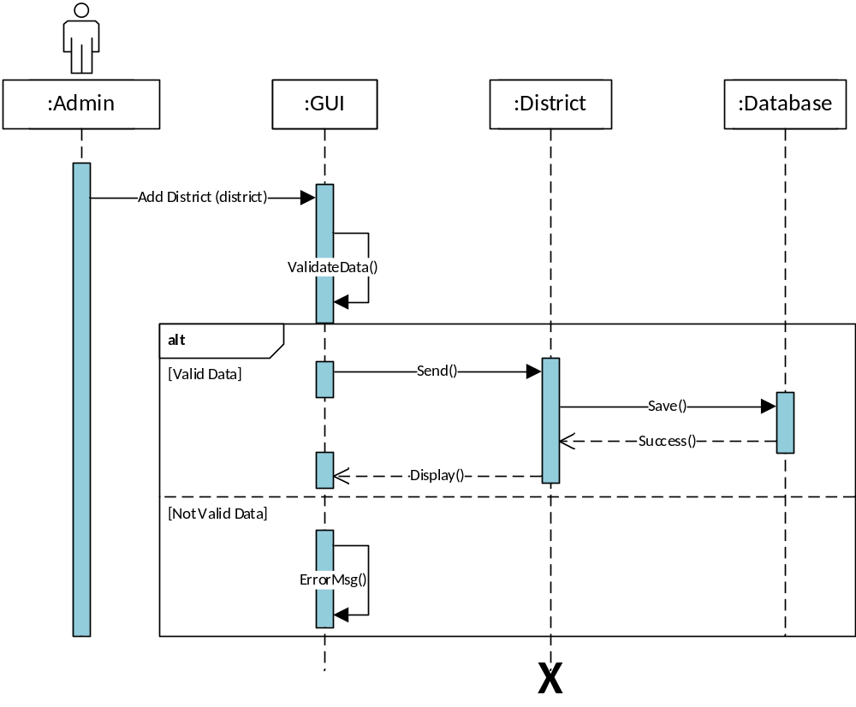
Sequence Diagrams
Add District Sequence

Slide 15

Sequence Diagrams
Add School Sequence

Slide 16
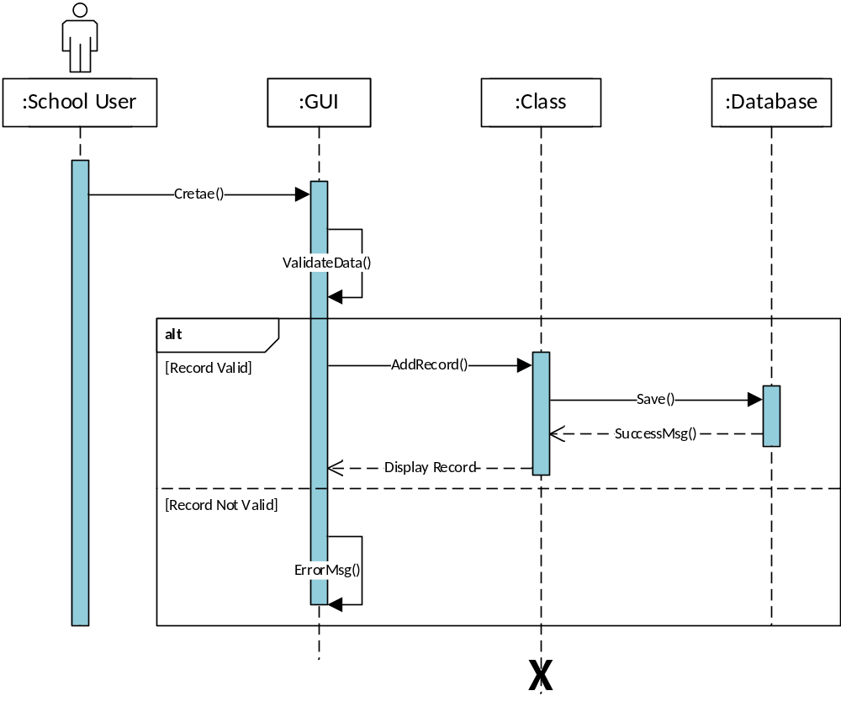
Sequence Diagrams
Create Class Sequence

Slide 17
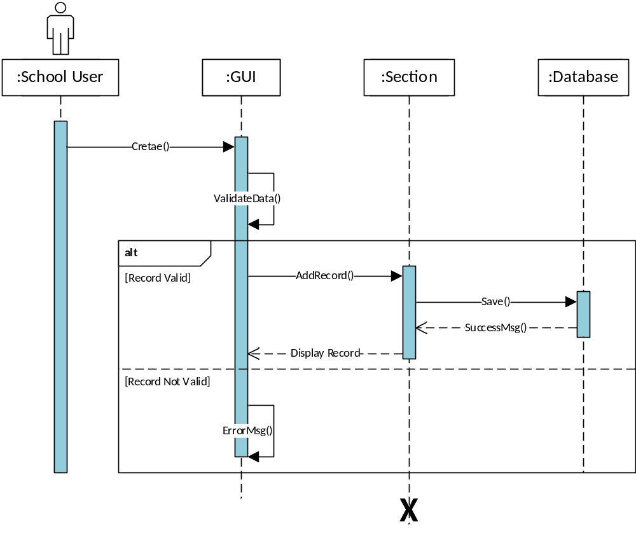
Sequence Diagrams
Create Section Sequence

Slide 18

Sequence Diagrams
Enter Student Data Sequence

Slide 19

Sequence Diagrams
Enter Staff Data Sequence

Slide 20
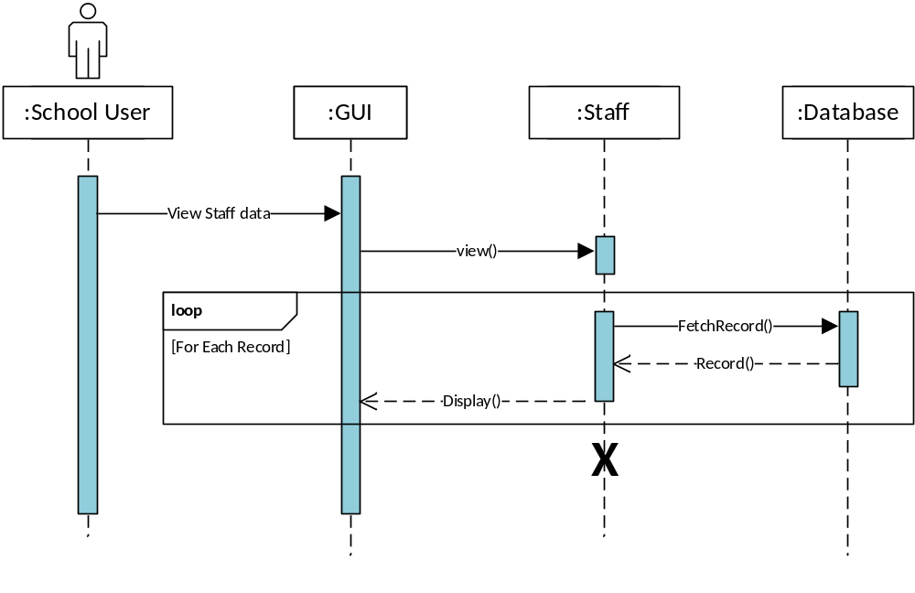
Sequence Diagrams
View Staff Data Sequence

Slide 21
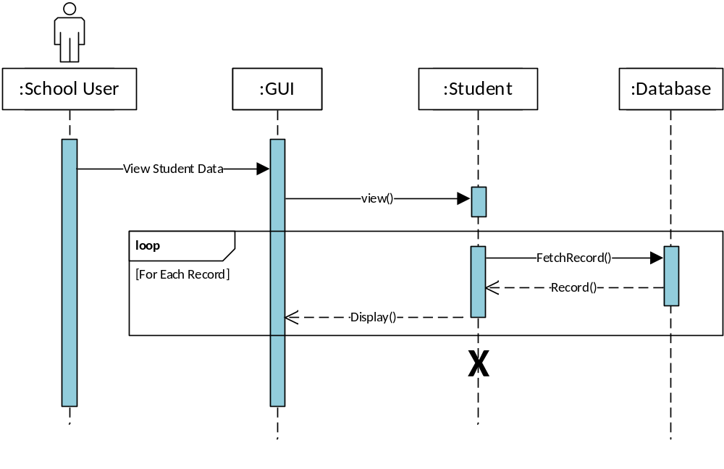
Sequence Diagrams
View Student Data Sequence

Slide 22
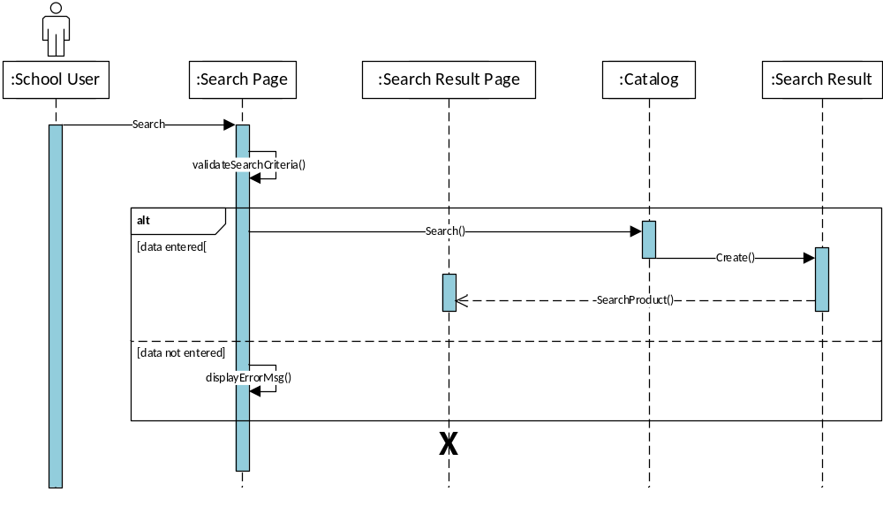
Sequence Diagrams
Search District Sequence

Slide 23
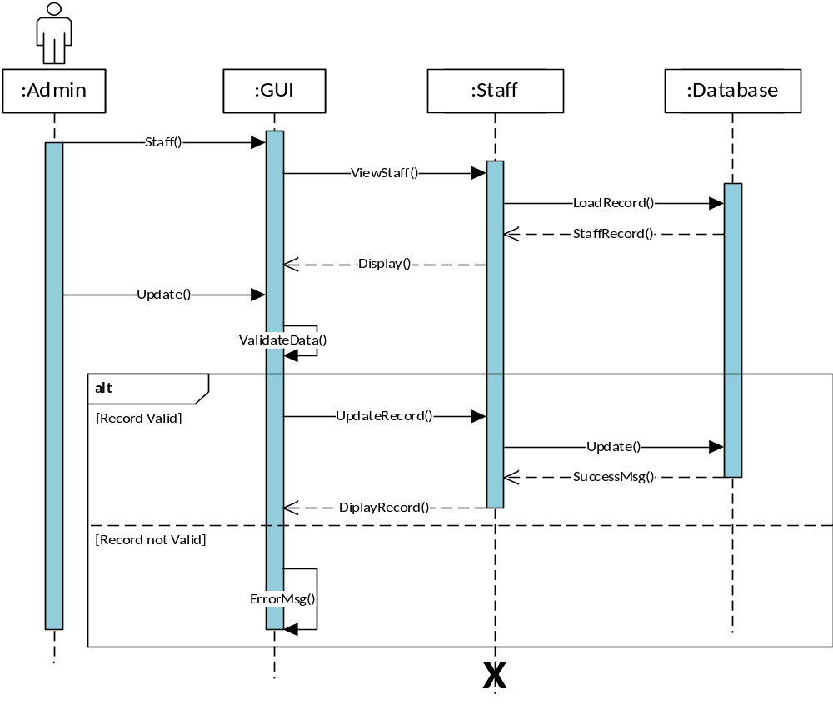
Sequence Diagrams
Manage Staff Data Sequence

Slide 24
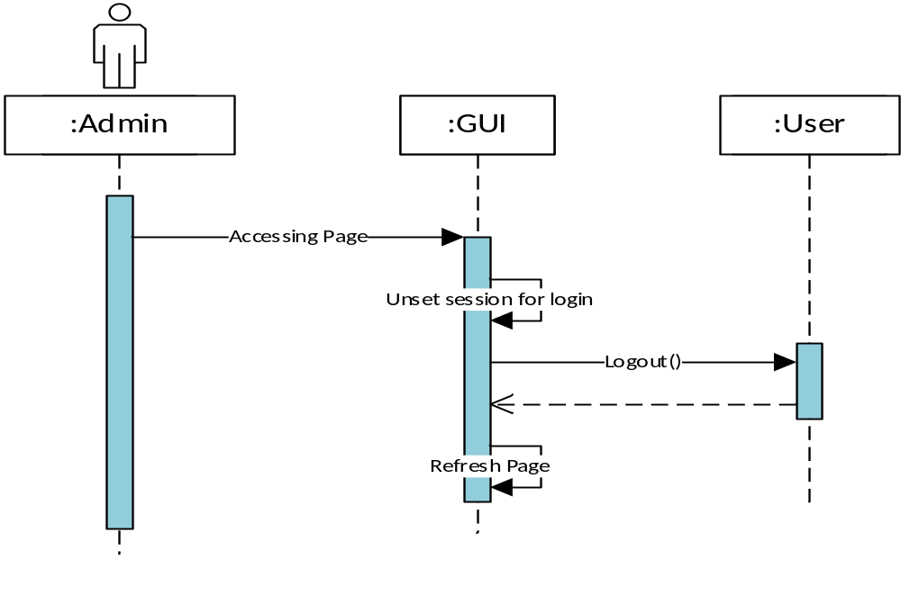
Sequence Diagrams
Logout Sequence

Slide 25
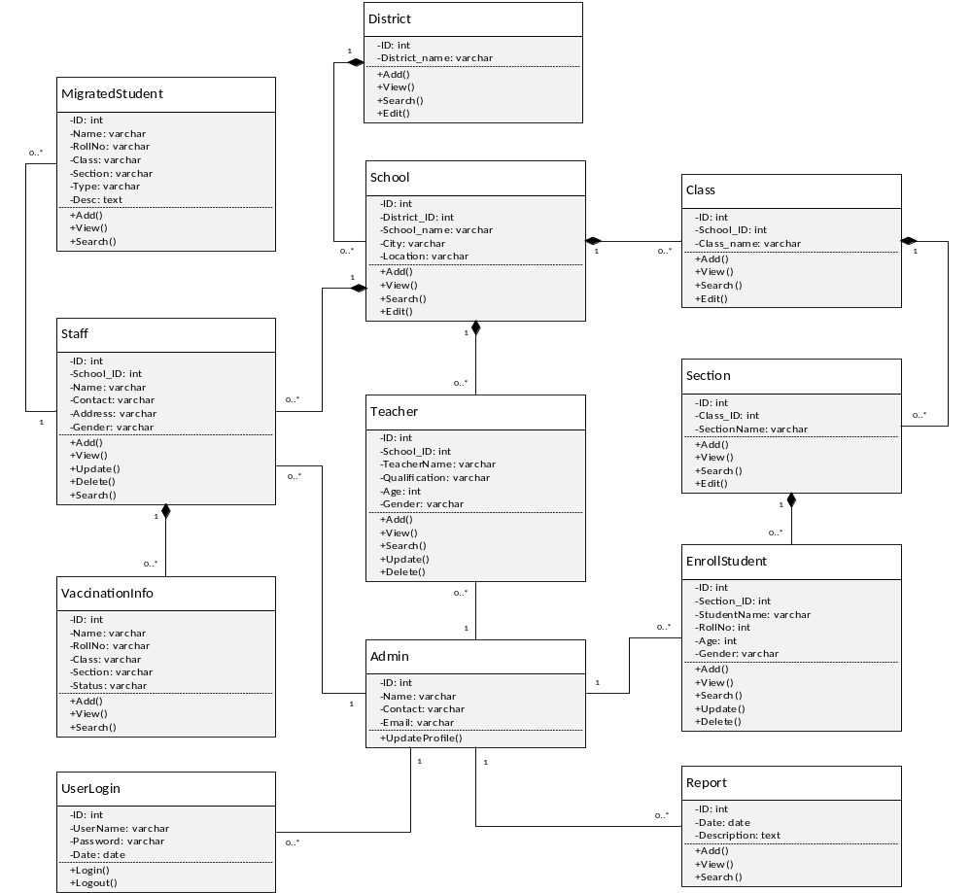
Logical Model/Class Diagram

Slide 26
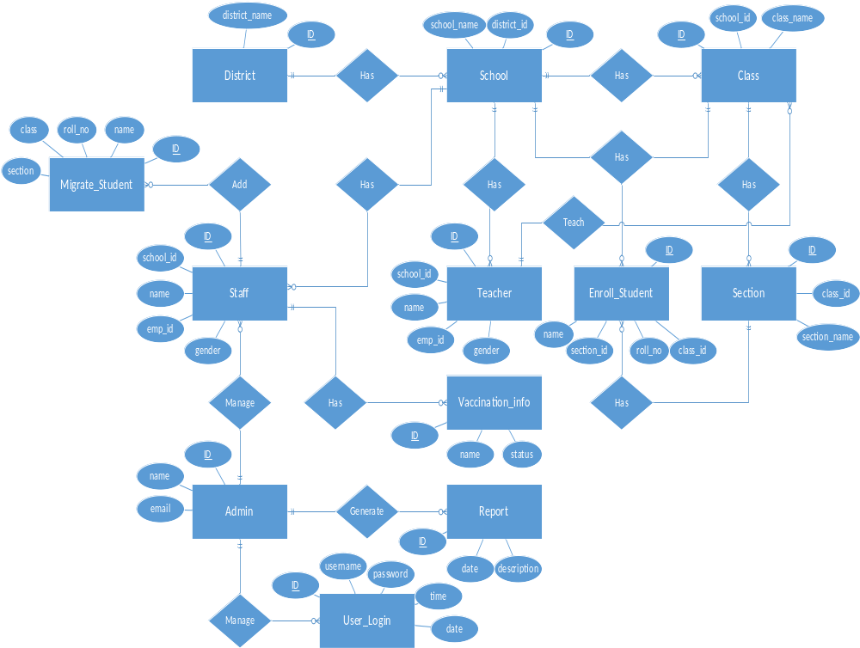
Entity-Relationship Diagram

Slide 27
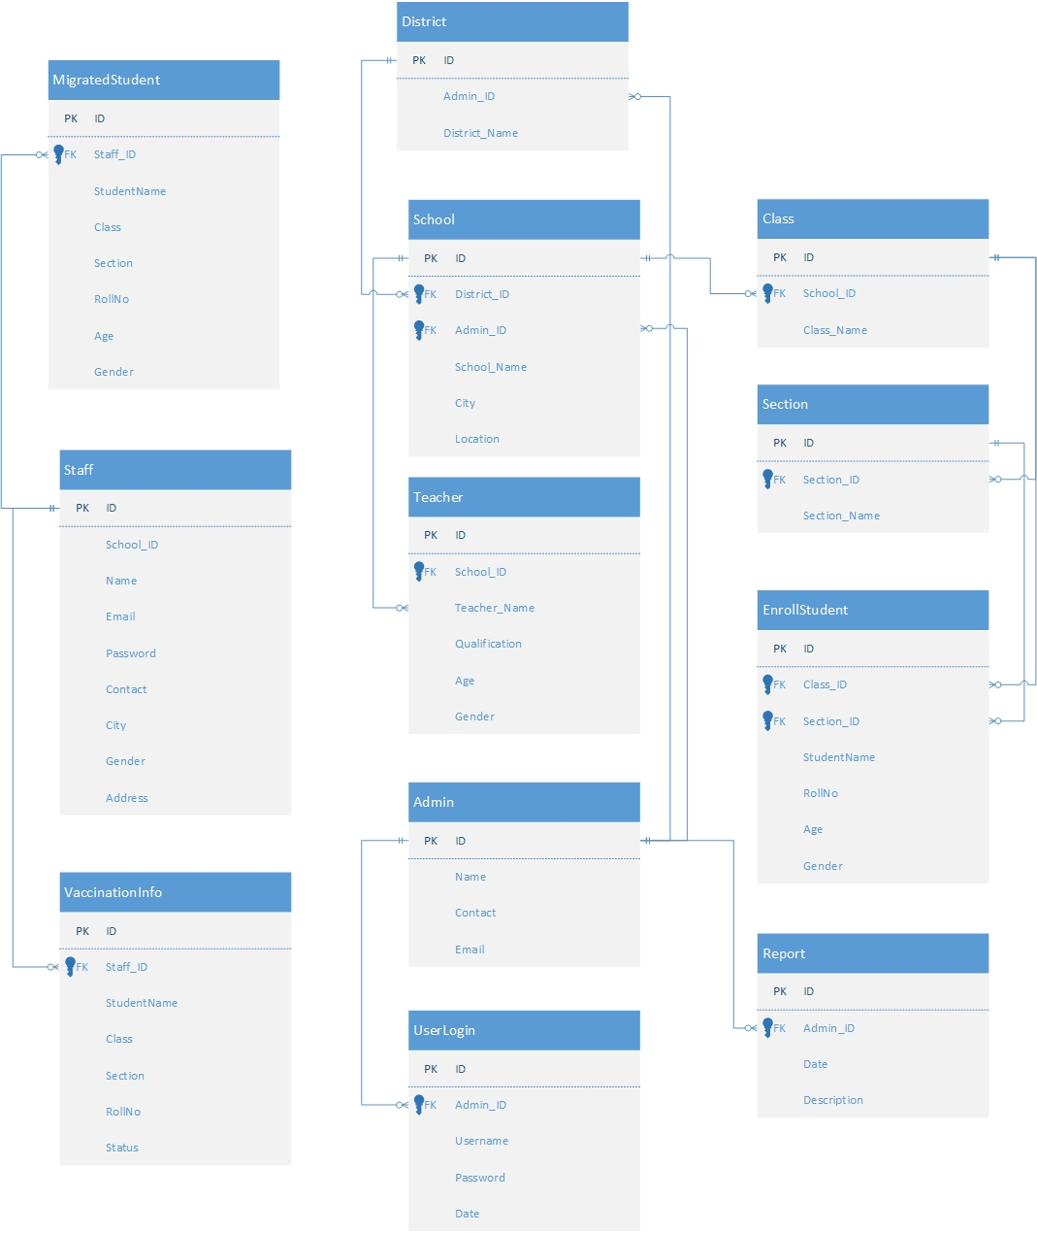
Database Diagram

Slide 28
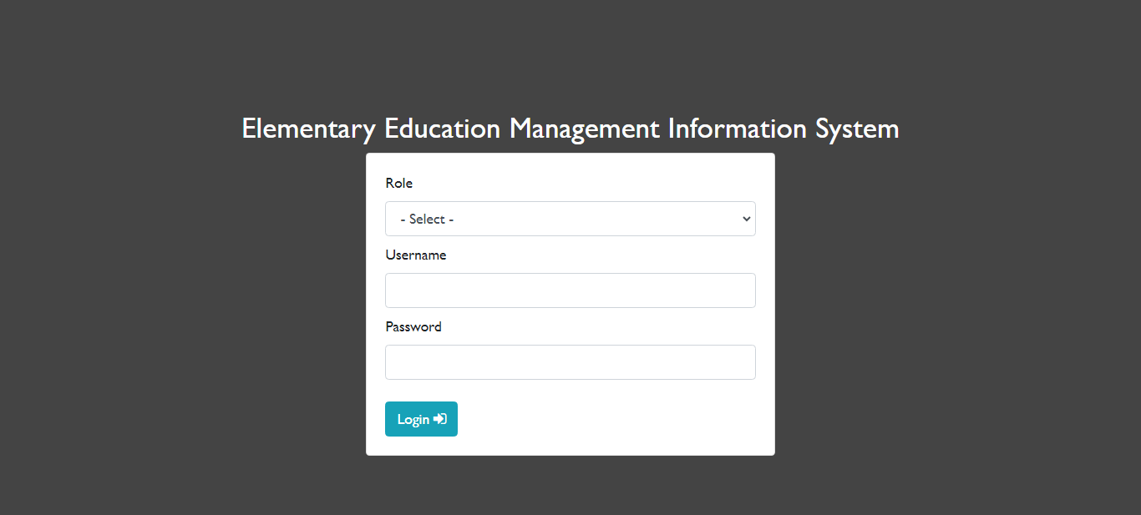
User Interfaces
Home Page

Slide 29
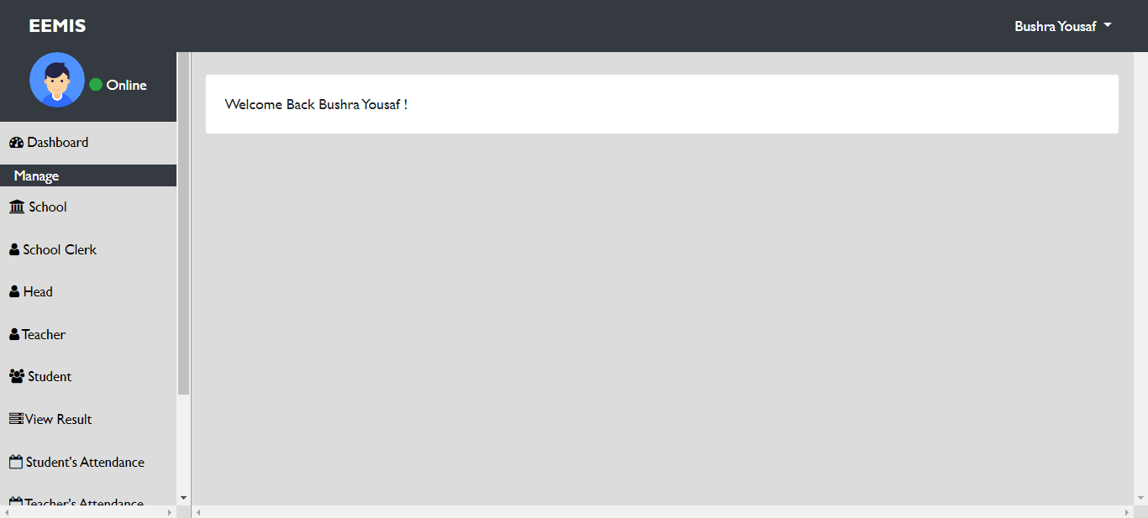
User Interfaces
Dashboard Page

Slide 30
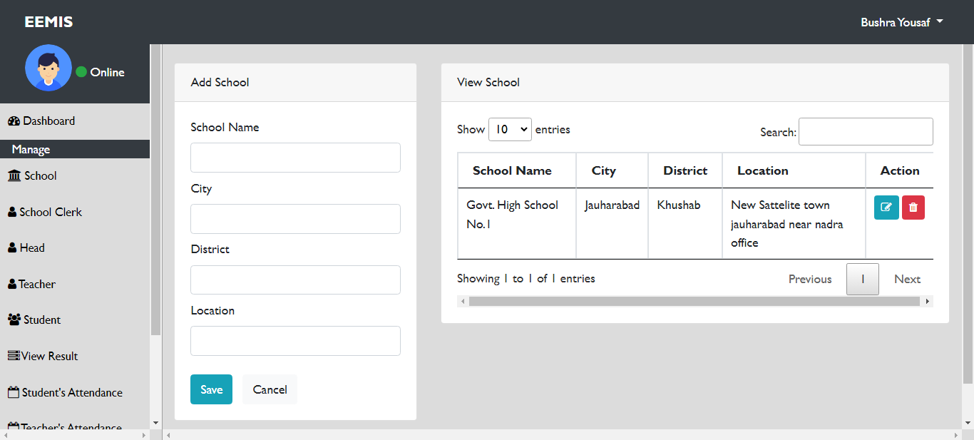
User Interfaces
Add/ View School

Slide 31
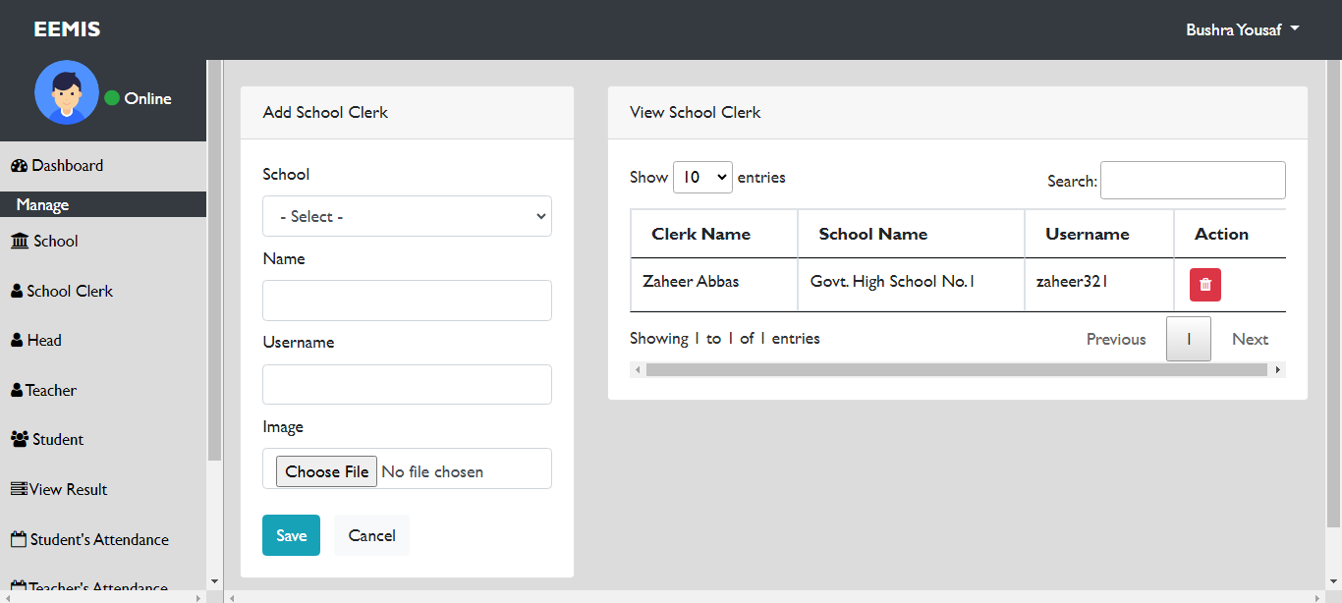
User Interfaces
Add/ View School Staff

Slide 32
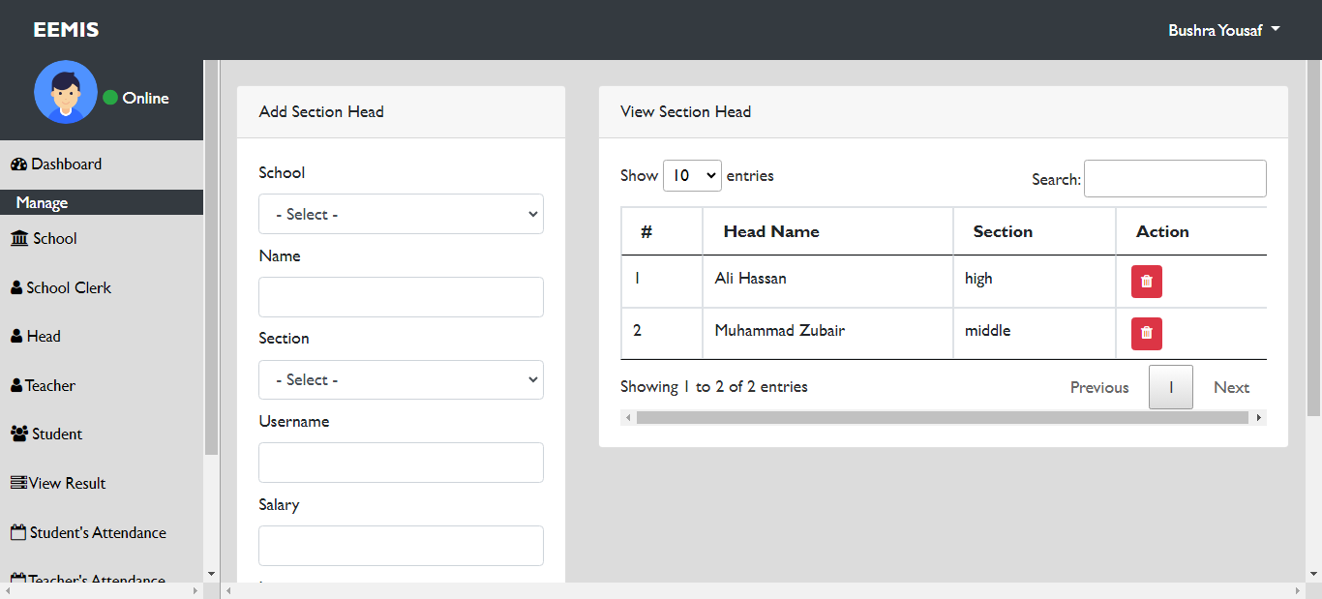
User Interfaces
Add/ View Section Head

Slide 33
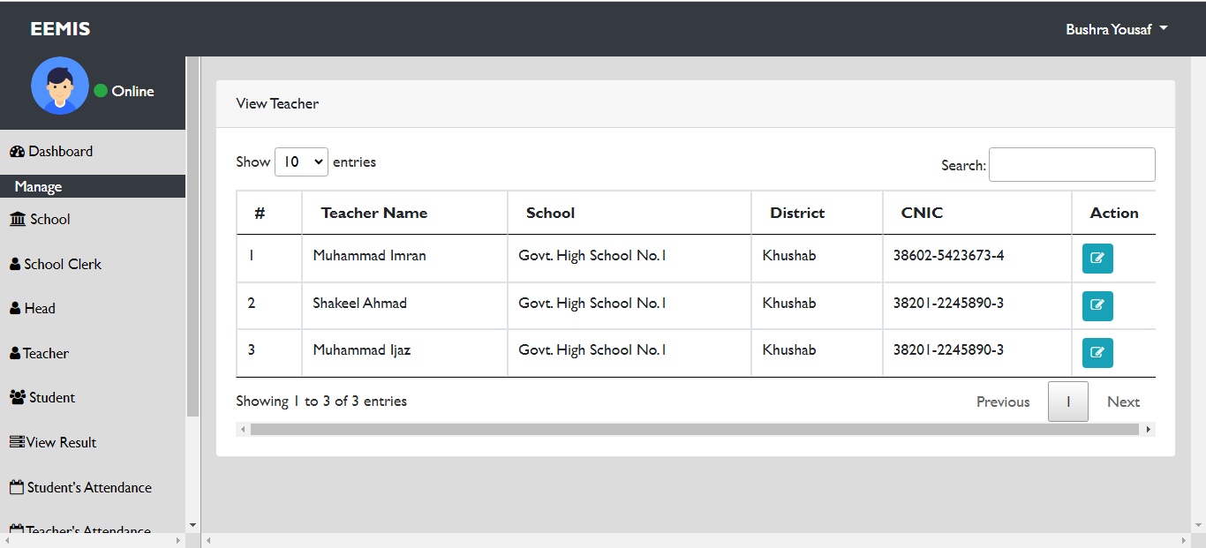
User Interfaces
View/ Search Teacher

Slide 34
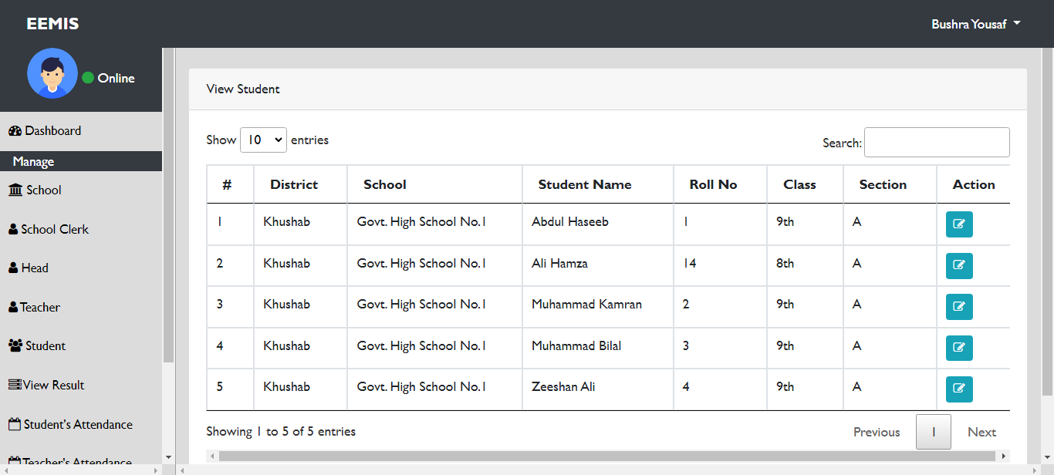
User Interfaces
Search/ View Student

Slide 35
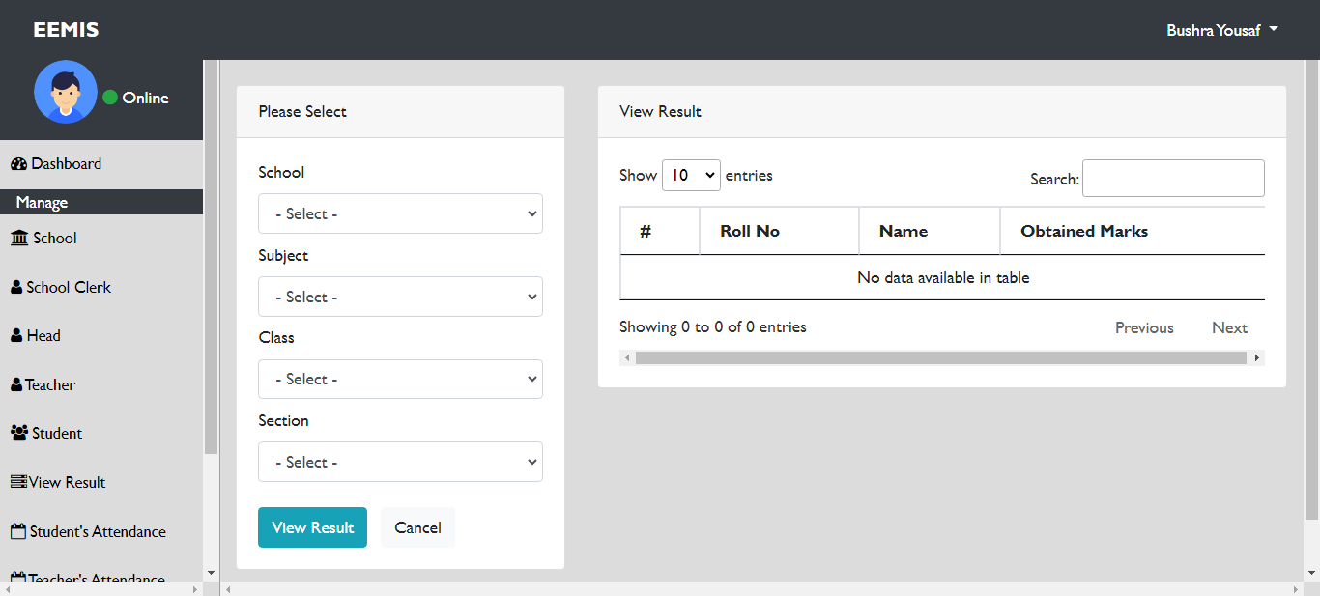
User Interfaces
Add/ View Result

Slide 36
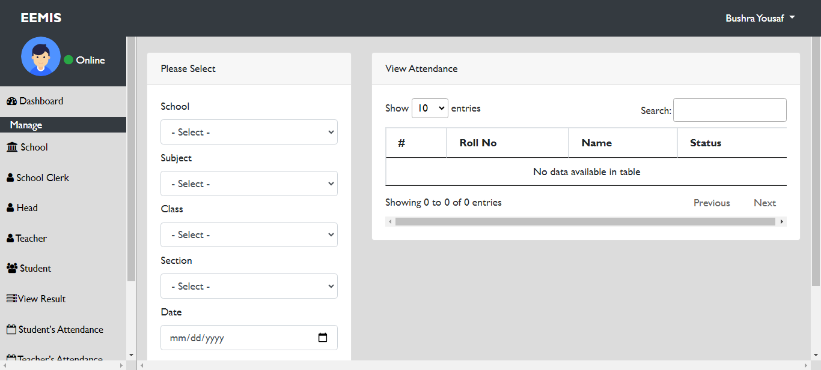
User Interfaces
Add/ View Attendance

Slide 37
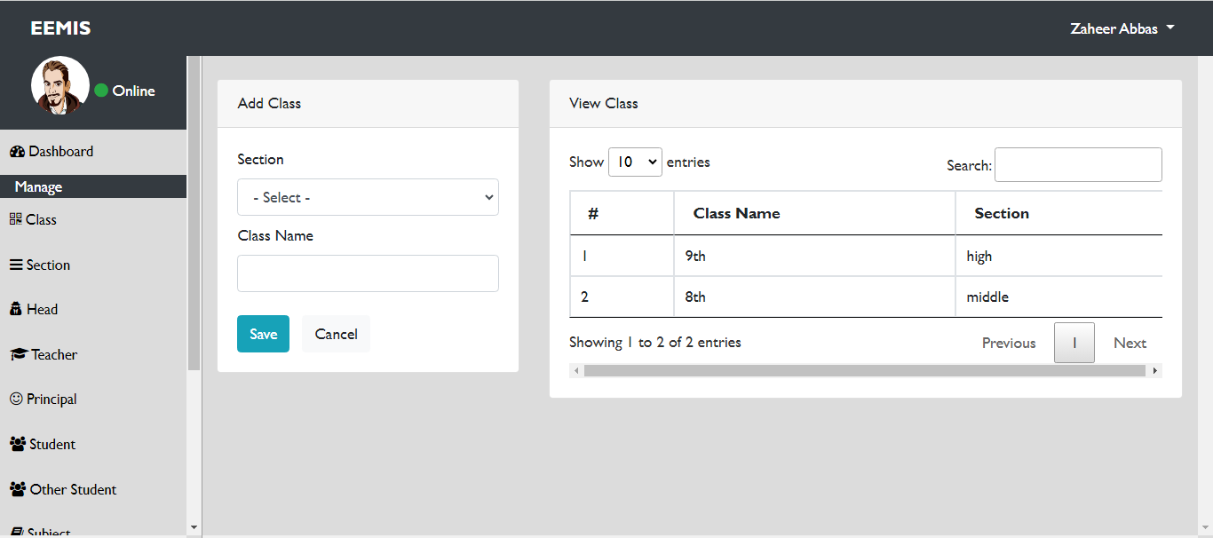
User Interfaces
Add/ View Class

Slide 38
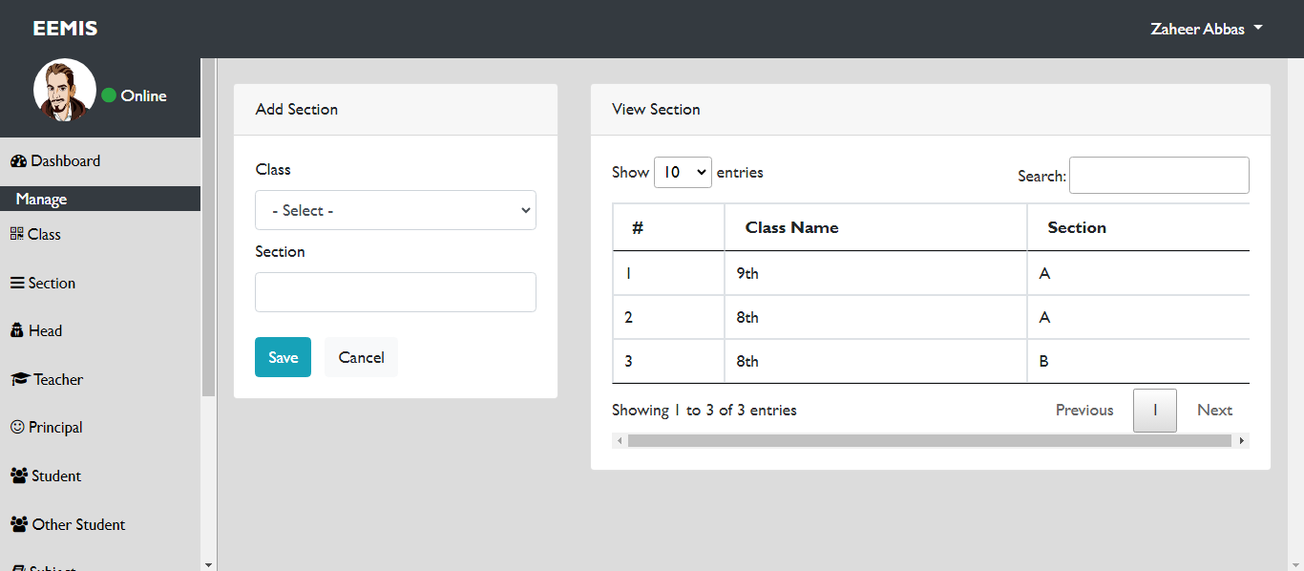
User Interfaces
Add/ View Section

Slide 39
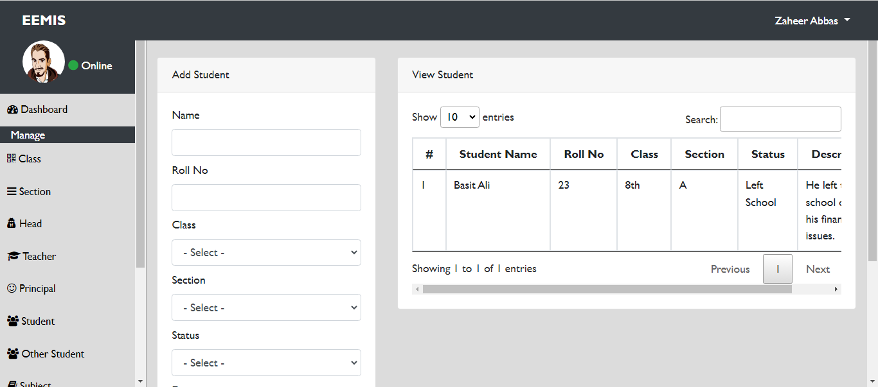
User Interfaces
Add/ View Student Left School/ Migrated

Slide 40
Tools
Sublime
Notepad
Notepad++
Adobe Dreamweaver
Xampp Server
Microsoft Visio
MS Office

